Slide 1
Photography
Sherie Kimble​

Slide 2


Sherie Kimble
K
I have been behind the camera for 15 years. I love macro photography but I have worked weddings, funerals, and church events.

Slide 3
The Northwest
A land of rain

Slide 4
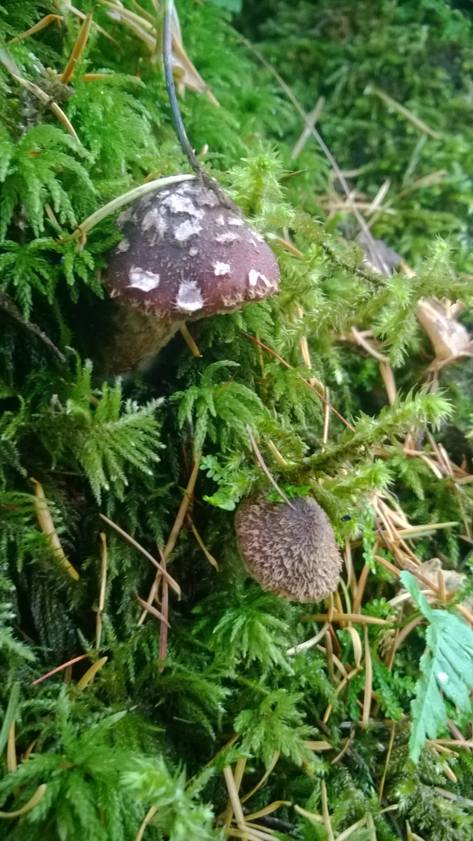

Slide 5
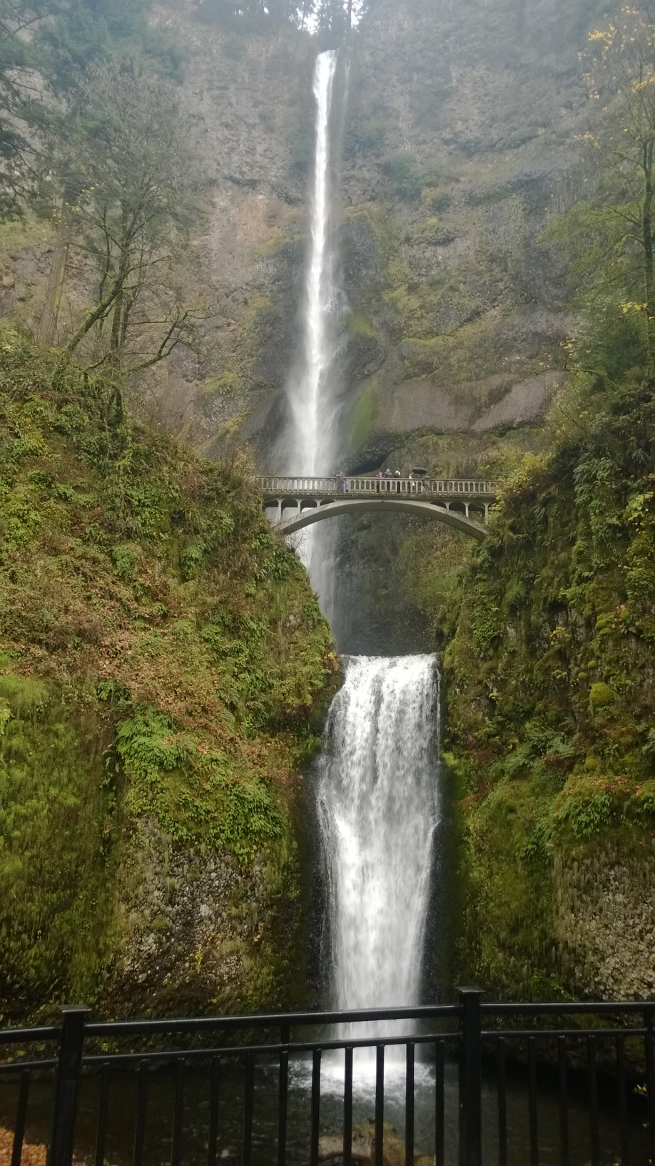

Slide 6
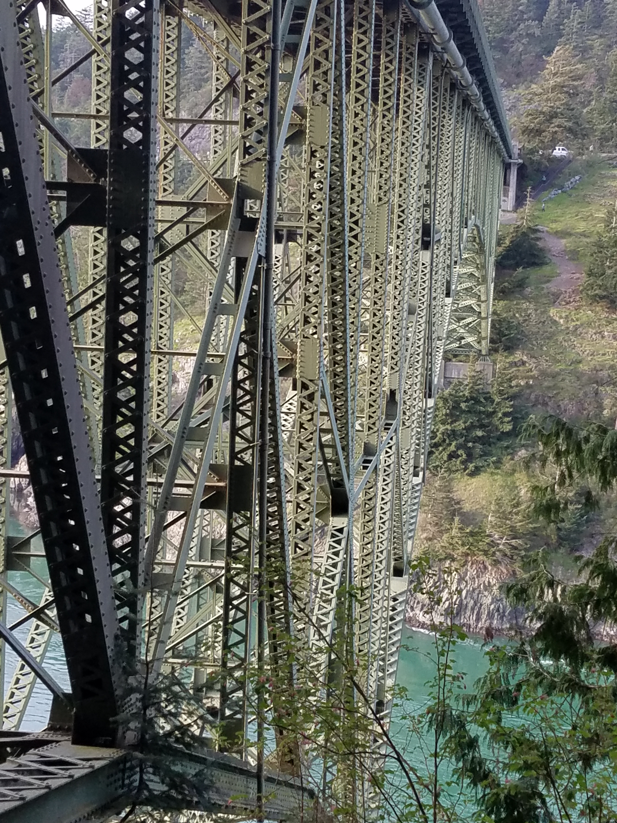

Slide 7
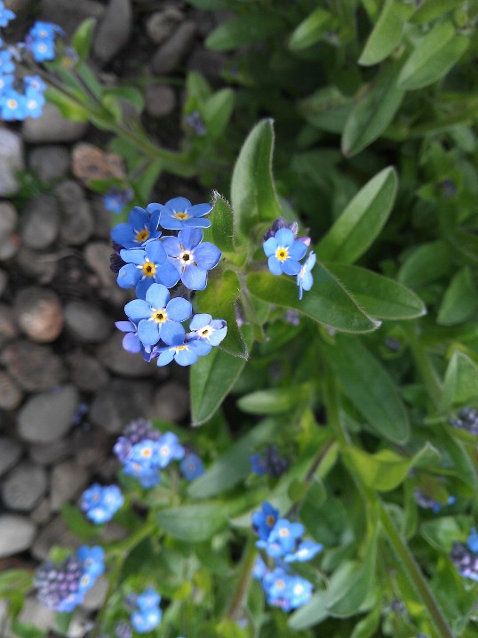

Slide 8
The Southwest
A land of little rain

Slide 9
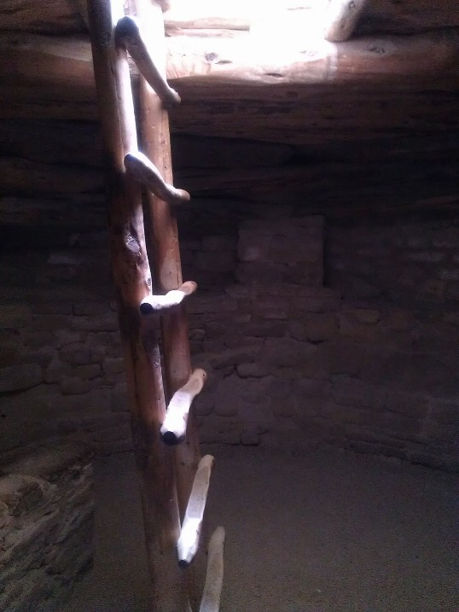

Slide 10
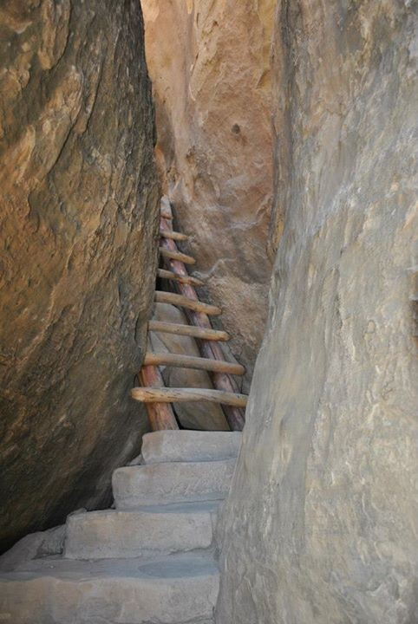

Slide 11
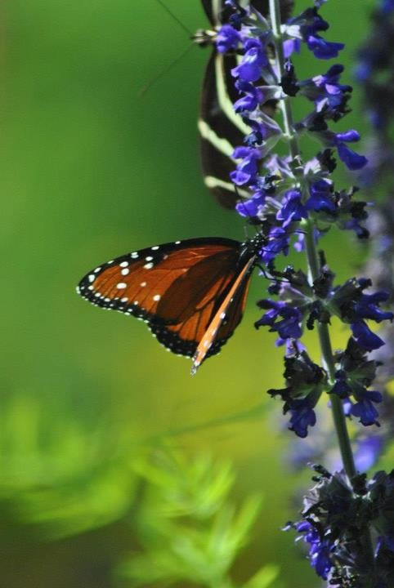

Slide 12
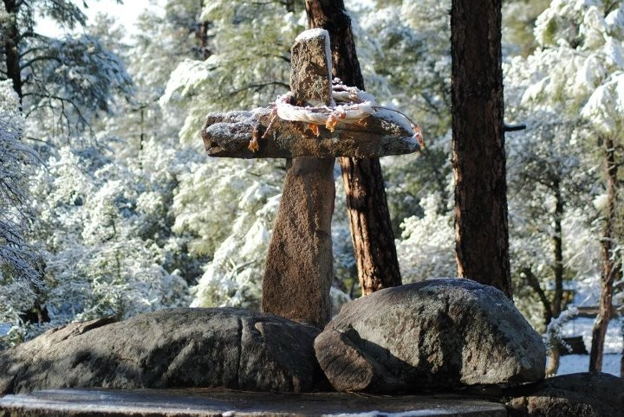

Slide 13
San Diego
The place you run to when it is too hot at home

Slide 14
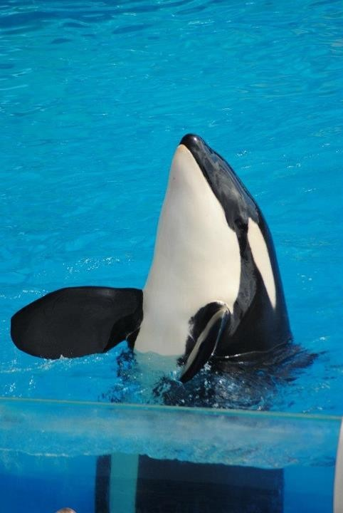

Slide 15
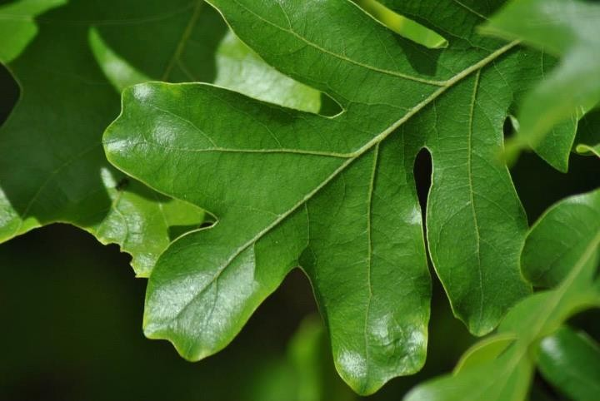

Slide 16
Colorado
Million Dollar Highway

Slide 17
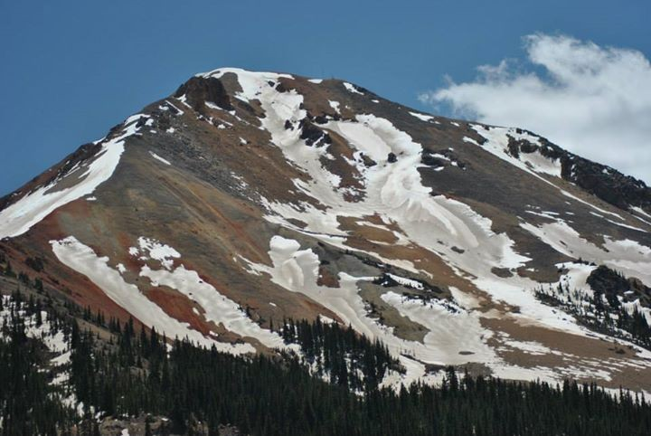

Slide 18
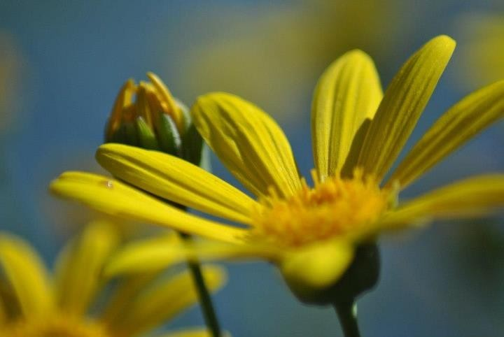

Slide 19
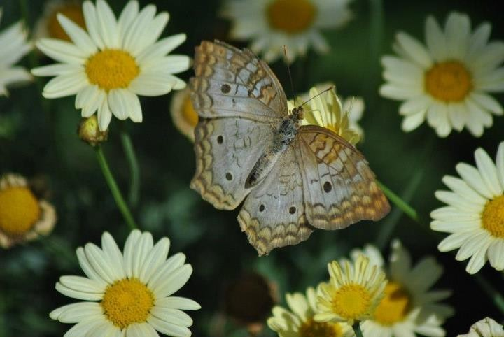

Slide 20
Headshots
Million Dollar Highway

Slide 21
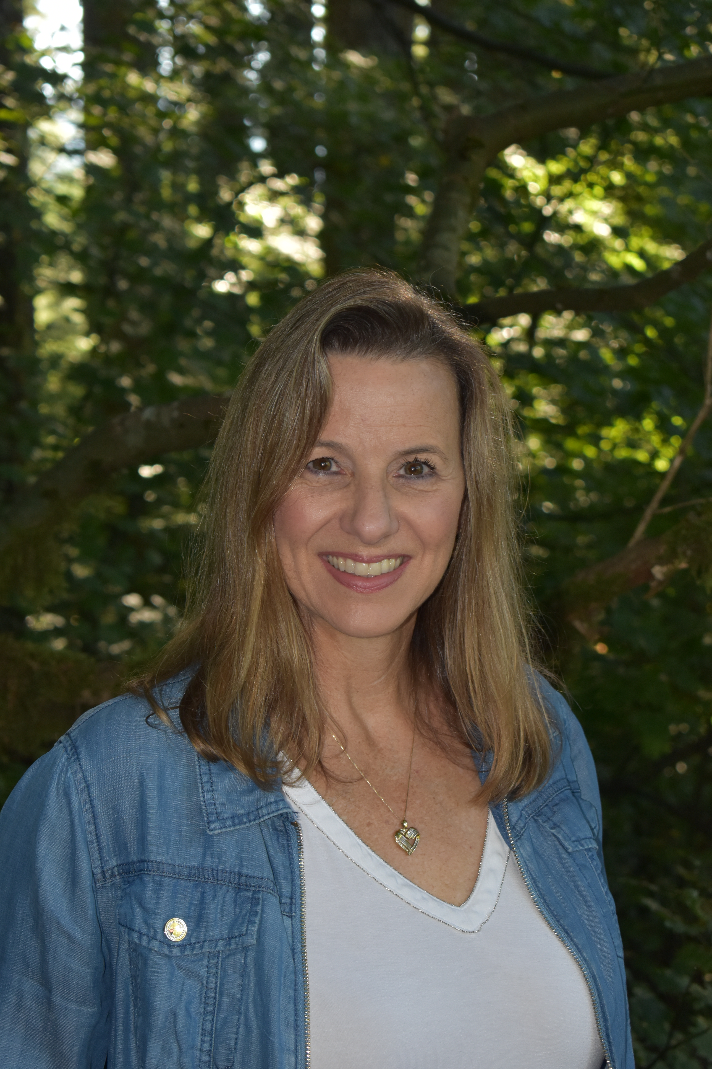

Slide 22
I believe I was always taking pictures, even before I had a camera.
“
”
Sabrina 1994

Slide 23
Thank you
Sherie Kimble​
fromaladybug@gmail.com
541-480-2495

